Slide 1
Sanitary Engineering
Sewerage Engineering
Secondary Treatment System
By
Dr. Muhanad M. Abbas

Slide 2
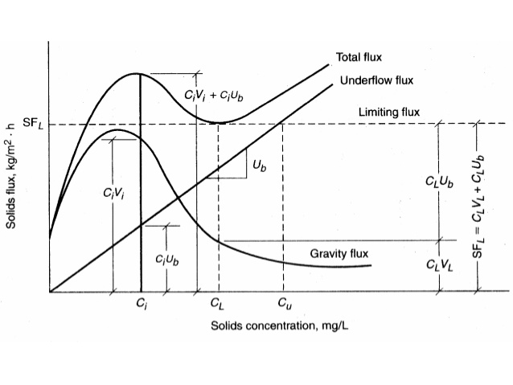
Solid flux (coe. & clevenyer, yoshiska ete.):
Downward velocity
* The transport velocity due to the withdraw of sludge.
*Gravity settling of the solid relative to the water.
G_{u}=V_{u} X_{i}
G_{g}=V_{g} X_{i}
G_{t}=G_{u}+ G_{g}

Slide 4
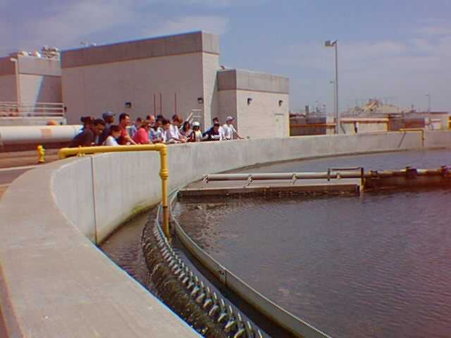

Slide 5
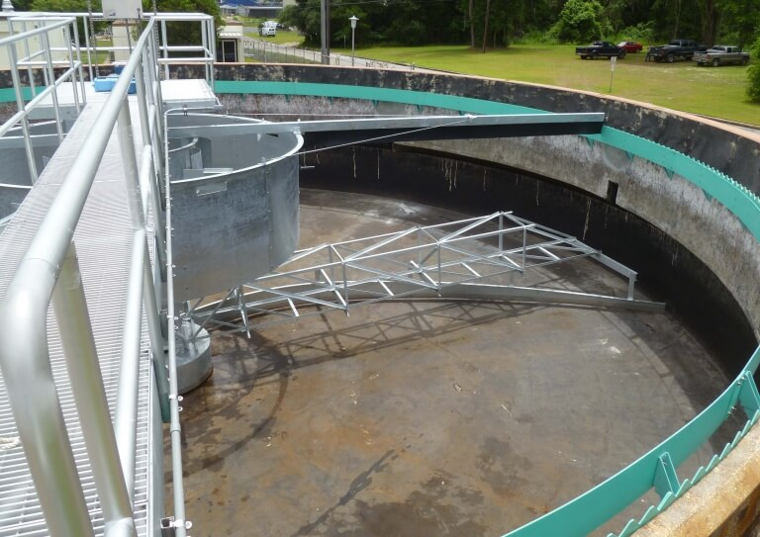

Slide 6
